Slide 1
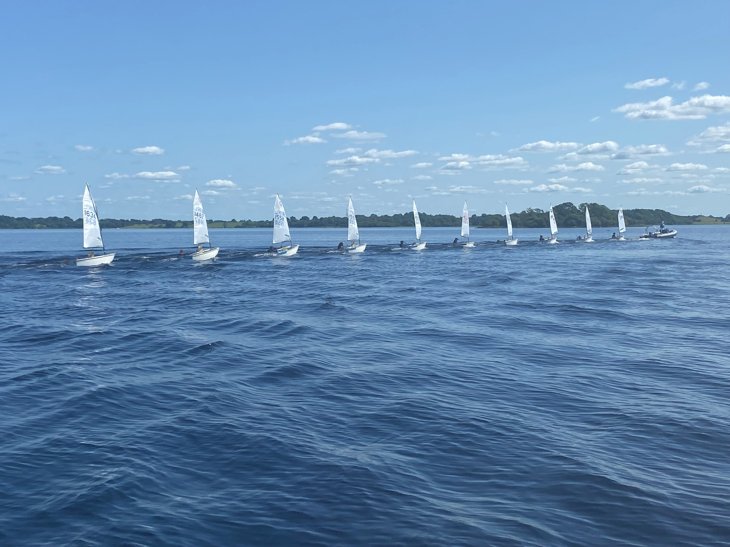
IODAI
General
Information

Slide 2
Governance
Retain knowledge and experience through Committee cycles
Seek counsel from our Advisory Board and Irish Sailing
Clear identification of committee members and their roles
Update and make assessable policy documents and class information
Effective and engaging communication with our membership

Slide 3
Goals and Objectives
Participation and Inclusion
Active engagement with clubs
Support of Regatta Coaching and Racing Fleets
Strengthen national presence and growth of fleet
Competition
Provide high quality events
Strengthening event management support and family involvement
Encouraging the best from our sailors to participate at all levels
Positive involvement with Teams Selection processes
Transition
Developing sailors for life Providing pathways to new classes
Building links with other class associations

Slide 4
IODAI 80:20
International Teams
NTW
Regatta Fleet
Regatta Racing
National Circuit
Junior & Senior Fleet
20
IODAI focuses nearly all resources on the 80%.
Delivering national events for all.
Establishing the Bronze Fleet
Coaching for developing young fleets.
Developing National Training Week.
Building an organisation focused
on families, sailors and inclusion.
YN are a chance to turn the focus
towards the 20% of the fleet.
80

Slide 5
Oppie sailor progression
Coached Regatta Fleet
Racing Regatta Fleet
Junior Main Fleet
Senior Main Fleet
Under 12
Fully supported by coaches
Meeting new friends
Being part of the ‘Event’
Developing new skills
Under 12
Introduction to racing
More formalised coaching structures
From Oppie 12 to 15
International Teams
Up to Oppie 12
Independence
No IODAI coaching support
Progression through Bronze, Silver and Gold Fleets
Development Squad
Youth Nationals

Slide 6
Youth Nationals - Qualification Process
Entry based on previous years effort and results.
Irish Nationals + two best regional events.
Oppie age 12 and up.
U12 Team sailors are not required to attend.
Criteria posted on IODAI website and qualified sailors list published.
Reflected in IS Youth Nationals NOR.
Reach out to Class Captains and IODAI direct for guidance and advice.
Sailors and families recommended to plan ahead.
2023 Results
(Nationals + 2 x Regionals)
2024 Youth Nationals
2024 IODAI Teams

