Slide 1
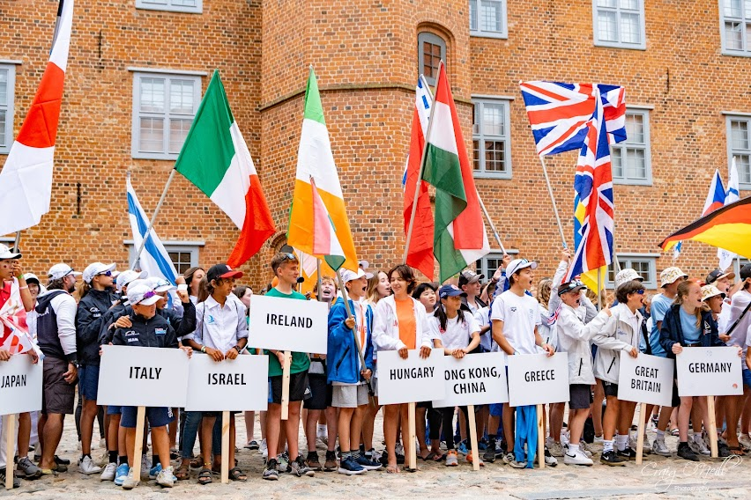
IS Youth Nationals & International
Teams 2023
Information Session
March 2023

Slide 2
Agenda
IODAI 80:20
IS Youth Nationals
Selection Process
Target Entrants
Teams Overview (Worlds, Euro, IDT)
Challenges & Opportunities

Slide 3
IODAI 80:20
International Teams
NTW
Regatta Fleet
Regatta Racing
National Circuit
Junior & Senior Fleet
20
IODAI focuses nearly all resources on the 80%.
Delivering national events for all.
Establishing the Bronze Fleet
Coaching for developing young fleets.
Developing National Training Week.
Building an organisation focused
on families, sailors and inclusion.
YN are a chance to turn the focus
towards the 20% of the fleet.
80

Slide 4
Youth Nationals – Purpose
Previously IODAI managed trials which was seen as somewhat separate to the Youth Nationals.
The international teams will be selected at the IS Youth Nationals.
Trials will no longer be a term used and we want to shift to Youth Nationals.
IODAI will rely on Irish Sailing governance for Youth Nationals with close consultation.
Benefits:
Improved alignment with ISA and other pathway classes (ILCA, 29er, 420 etc)
Benefit from an exposure to other classes in a youth environment
Develop relationships with talented sailors
More obviously connect the pathway from Oppies into other classes
Exposure to a high level of competition and race organisation
Sail in challenging conditions at the start of the season

Slide 5
Youth Nationals - Qualification Process
Entry to Youth Nationals is based on previous years effort and results.
Specifically based on previous results, Irish Nationals + two best regional events.
Minimum cut off point developed by IODAI and communicated to IS.
Criteria posted on IODAI website and qualified sailors list published.
IS Youth Nationals NOR reflects the IODAI input to entry criteria.
Reach out to Class Captains and IODAI direct for guidance and advice.
Sailors and families need to plan ahead if teams are something they desire.
2022 Results
(Nationals + 2 x Regionals)
2023 Youth Nationals
2023 IODAI Teams

Slide 6
Youth Nationals - Target Sailors
It is not intended to be an event for the whole Irish Optimist class.
Only the top 20 sailors in the country will make a team!
Sailors will be under pressure to perform as they would at an international event.
Sailors are expected to have a high degree of independence
Best suited to the senior fleet sailors.
Not suggested for bronze fleet sailors, U12 sailors or sailors without a sufficient degree of racing and pre Youth Nationals training experience.
Likely strong weather conditions at this time of year and racing is teams appropriate.
There will be no IODAI presence or parents present on the water.
The Racing Rules will be strictly applied, as will class rules throughout the event & an outer time limit of 20 mins from the first boat finished will be strictly applied without exception.

Slide 7
Worlds Team
Top 5 sailors regardless of gender.
Costa Brava, Spain. June.
Coach – Dennis Paaske
52 Nations Entered
Training weekends
April 28th, 29th & 1st May
June 3rd, 4th & 5th
Cost – Circa €6,000
Travel days = 11
IODAI Team Rep Supporting

Slide 8
European Team
Next 7 sailors (max 4 from one gender)
Thessaloniki, Greece, July
Coach – Soren Laugesen
44 Nations Entered
Training weekends
April 28th, 29th & 1st May
June 3rd, 4th & 5th
Cost – Circa €5,000
Travel days = 10
IODAI Team Rep Supporting

Slide 9
IDT Team
Next 8 sailors (max 5 from one gender)
Perros-Guirec, France, July
French Open Nationals ~400 sailors.
Coach – Thomas Chaix
Training clinic
June 26th , 27th & 28th
Cost – Circa €4,000
Travel days = 8
Parent support permitted.

Slide 10
Challenges & Opportunities
Challenges:
Racing is at a really high level.
Sailors are in it to win and international competition is very serious.
Events can have 300 / 400 + sailors.
Mental toughness and resilience skills may be tested.
Sailors need a high degree of self awareness, life skills and independence.
Costs are significant.
Opportunities:
Learning with top level international coaches and sailing with peer sailors.
Enjoy a memorable and successful trip /adventure that enhances sailing skills.
Gain experience & competence in competing in international events.
Develop independence and resilience in a safe, controlled environment.
Build lasting friendships with their fellow teammates and competitors.
Experience competing in a high quality, high standard international sailing environment.
Provides a learning experience, as well as a sailing experience.

Slide 11
Q&A
Further enquiries: teams@iodai.com

